Slide 1


Laboratory Measurements of the Thickness, Index of Refraction, and Density of Ices Important to
Planetary Science
Moises Gomez
Advisor: Dr. Stephen Tegler
Department of Astronomy and Planetary Science

Slide 2
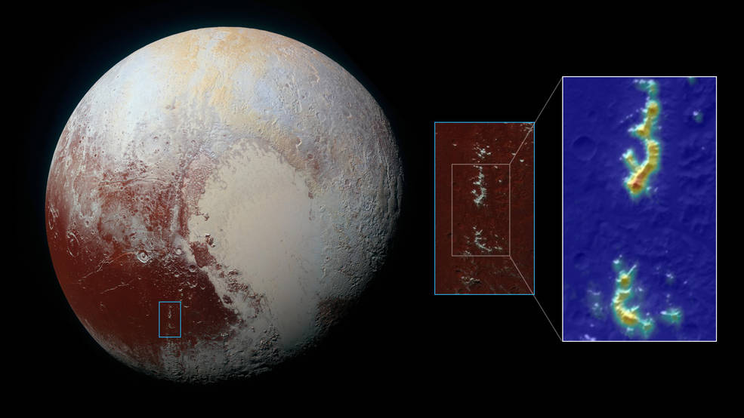
Methane ice on Pluto mapped by the New Horizon’s spacecraft. (Source: NASA)

Slide 3
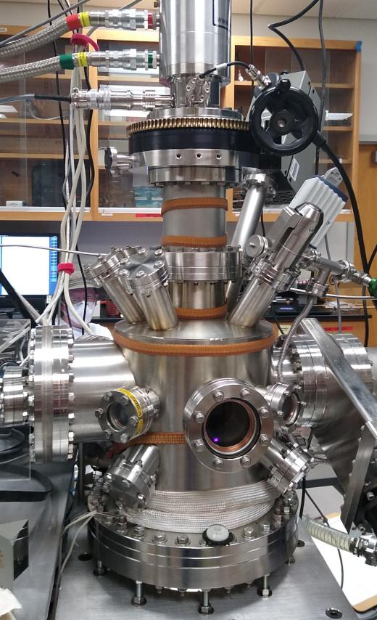
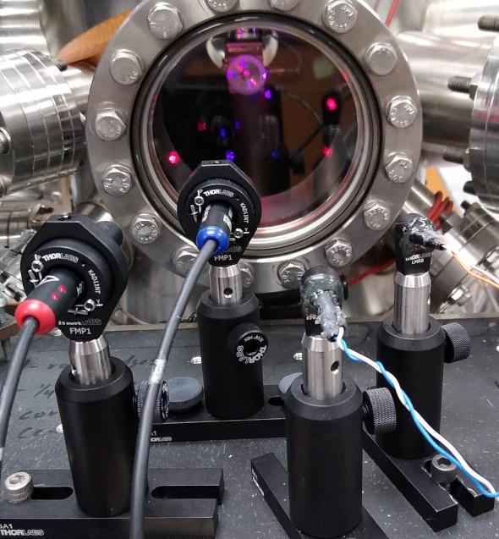
Deposited ice mixtures of CH₄ and N₂ onto a substrate inside of vacuum chamber.
Pressure around 5 * 10⁻⁹ torr and temperatures ranging from 10-30K.
Thin films of ice < 1 micron thick.
*Picture of the entire chamber*

Slide 4
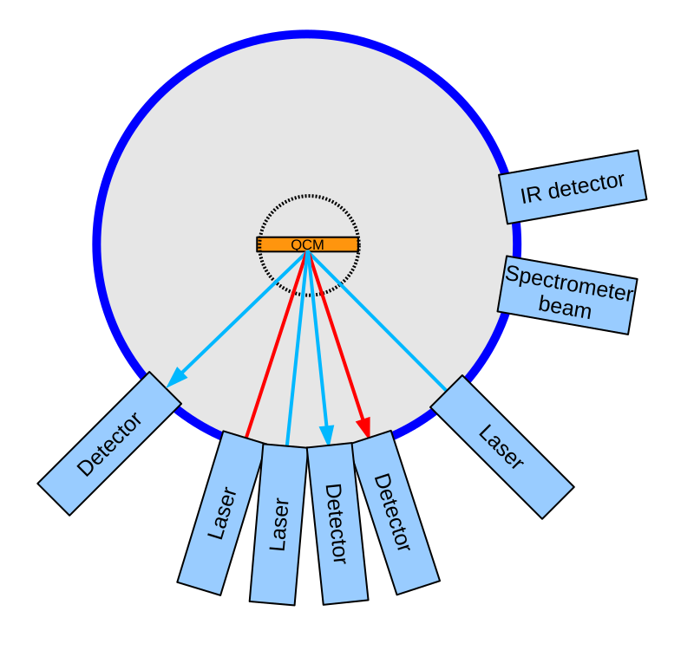
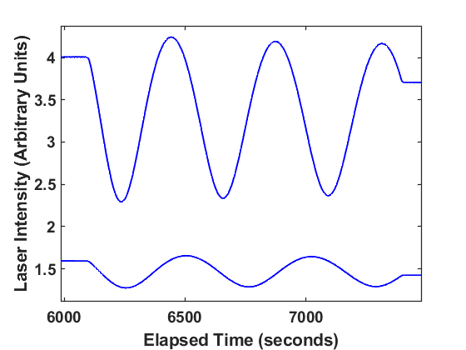
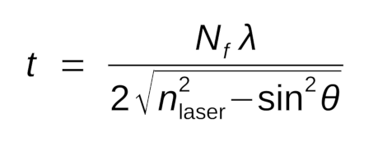
Lab Setup (Pt. 1 QCM, Las
Laser fringe data obtained from a N₂ and CH₄ (ratio 60:40) ice mixture at 10K.

Slide 5
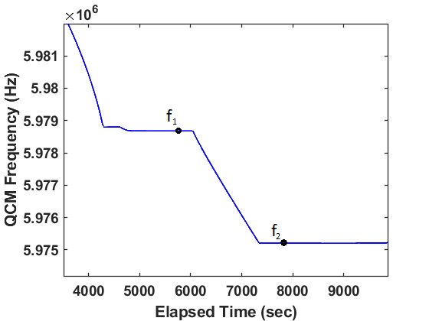
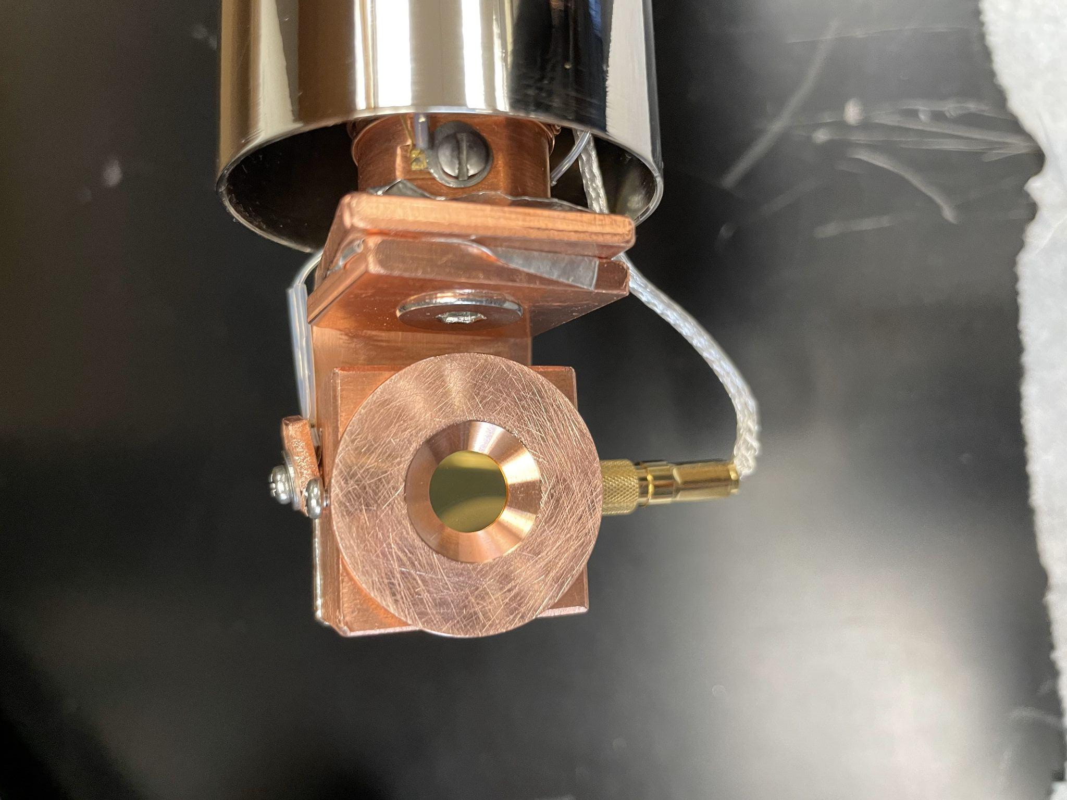
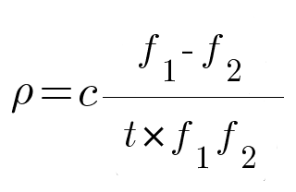
Quartz Crystal Microbalance (QCM)
QCM frequency data obtained from a N₂ and CH₄ (60:40) at 10K.

Slide 6
Optical Constants of CH₄ and N₂ ice at 10K
Sample | Ratio | Thickness (microns) | Density (g/cm³) | Compared Density (g/cm³) | n_{vis} | Compared n_{vis}
N₂:CH₄ | 0:100 | 0.44 | 0.49 | 0.49* | 1.32 | 1.30*
N₂:CH₄ | 60:40 | 0.61 | 0.71 | — | 1.33 | —
N₂:CH₄ | 80:20 | 0.95 | 0.93 | — | 1.28 | —
N₂:CH₄ | 100:0 | 1.26 | 0.98 | 0.95* | 1.22 | 1.22*
*Satorre, M. Á., et al. "Density of CH4, N2 and CO2 ices at different temperatures of deposition." Planetary and Space Science 56.13 (2008): 1748-1752.

Slide 7
Thank You!
Acknowledgement to:
NASA/NAU Space Grant
Dr. Stephen Tegler
Dr. Will Grundy
Aidan Madden-Watson

